Slide 1


The Technological Servants of the Future: Voice Assistants
By: Zaina Khawaja

Slide 2
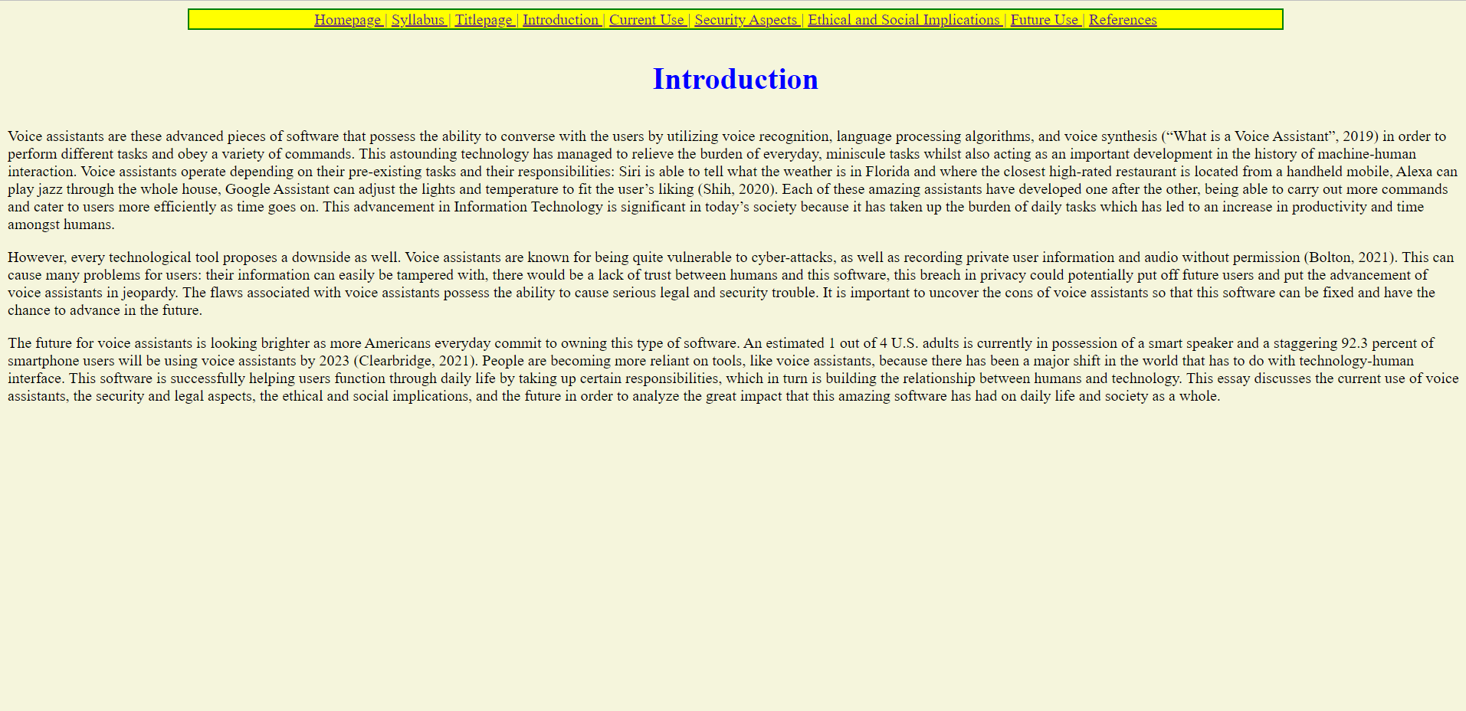

Slide 3
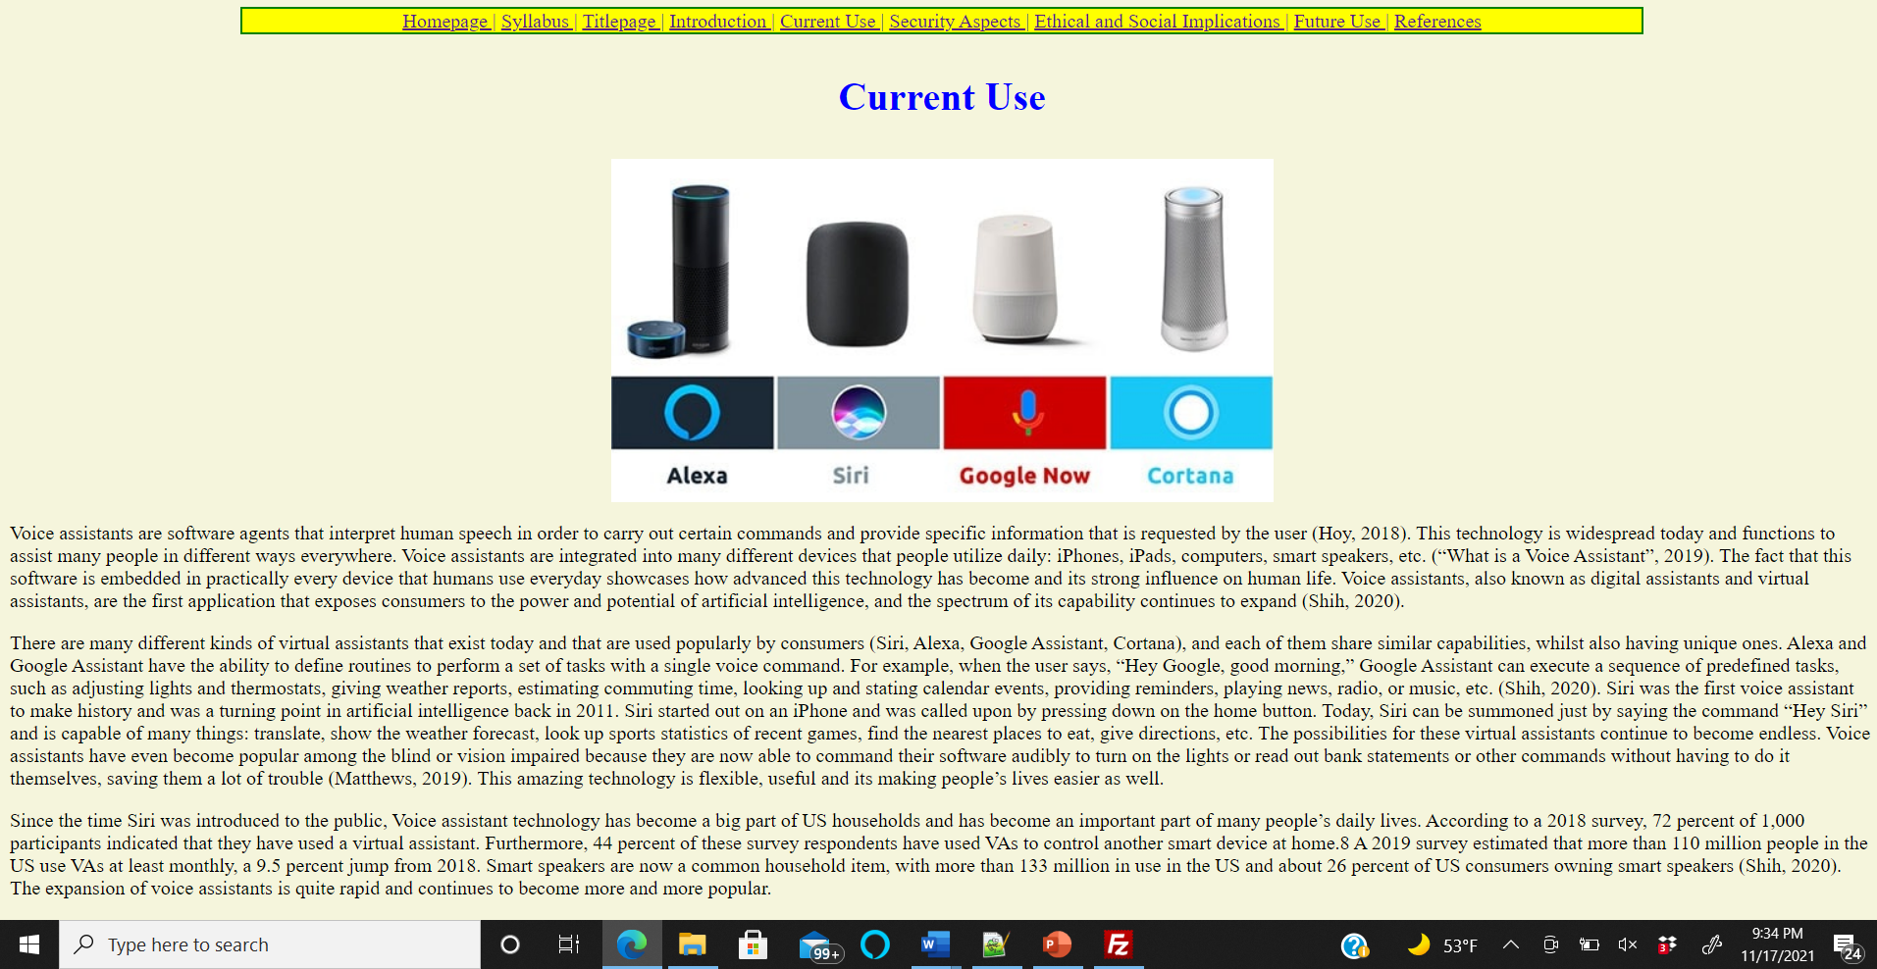

Slide 4
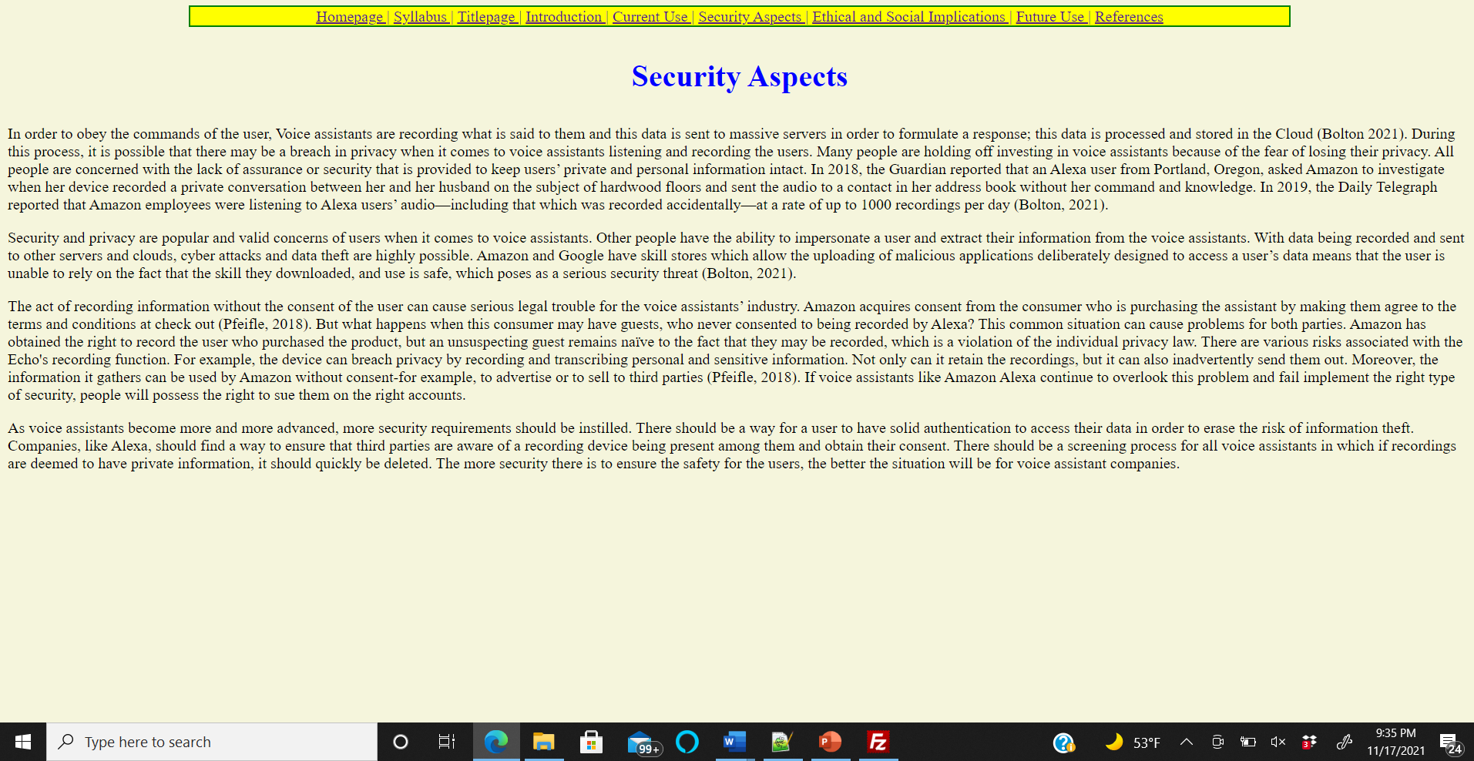

Slide 5
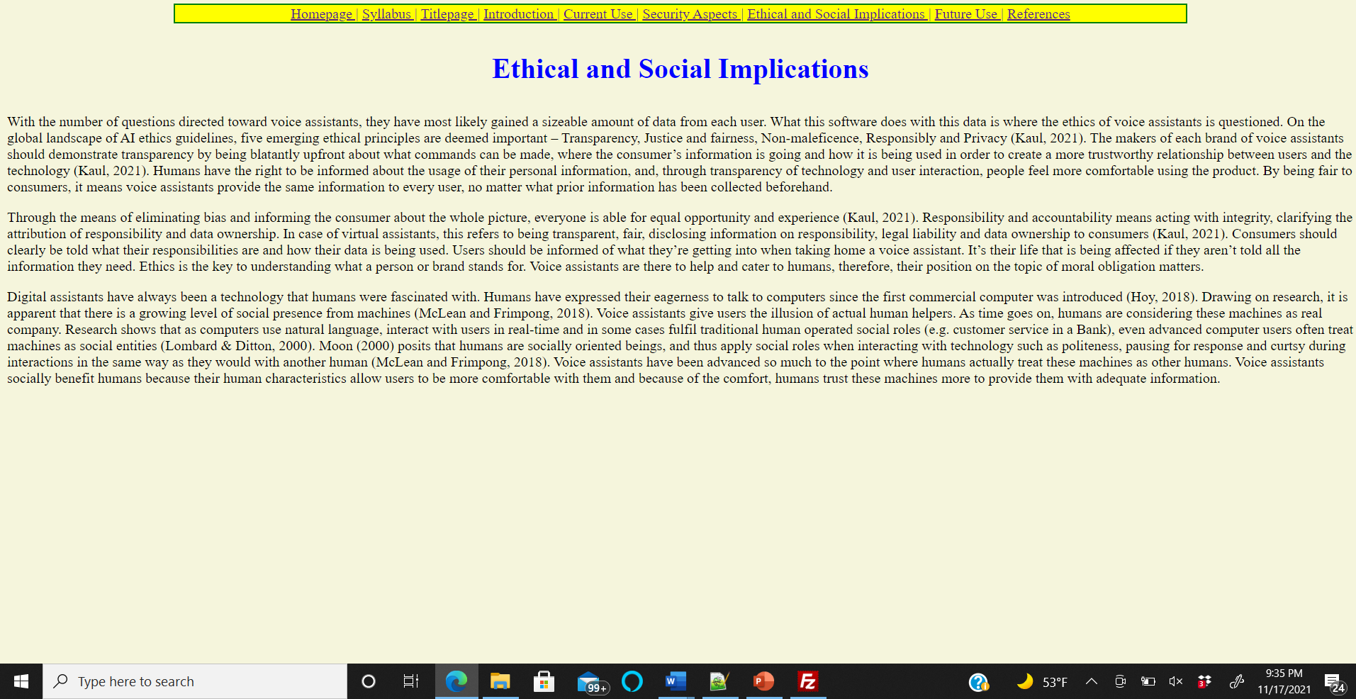

Slide 6
